Slide 1
Login page

Slide 2
approach
I have created in login page with username and password.
The username is admin.
The password is also admin.

Slide 3
It will appeard in Login title and two labels those are username and password and sign in button.
If user enter the correct username and password the message will come.That message is Login Successful!
User enter the wrong details in the username and password then it will show the error message.that is please enter correct username and password.

Slide 4

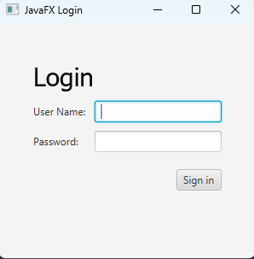
Result

Slide 5
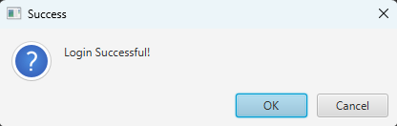

Slide 6
